Slide 1
Unit tests with Mockito
--By Shengli

Slide 2
Unit Test
A unit test should test a class in isolation.
Side effects from other classes or the system should be eliminated if possible.

Slide 3
Creating and configuring mock objects
MyClass test = Mockito.mock(MyClass.class);
public class MockitoTest {
@Mock
MyObject objectMock;
@Rule public MockitoRule mockitoRule = MockitoJUnit.rule();
…
}
public class MockitoTest {
@Mock
MyObject objectMock;
@BeforeClass
public static void setUp() {
MockitoAnnotations.initMocks(this)
}
...
}

Slide 4
Creating and configuring mock objects
@RunWith(MockitoJUnitRunner.class)
public class MockitoTest {
@Mock
MyObject objectMock;
...
}

Slide 5
Inject mocks
Source code | ... public class ProcessControllerBean ... { @EJB private ITrigramServiceLocal trigramService; ... }
Test code | @Mock (name = "trigramService") // same as the field name private ITrigramServiceLocal trigramService; // If ProcessControllerBean have one ITrigramServiceLocal type only, // Mockito will inject this mock into ProcessControllerBean. // Regardless the name match or not. @InjectMocks private ProcessControllerBean controller; @Before public void setUp() throws Exception { MockitoAnnotations.initMocks(this); // initialization }
Mocks will first be resolved by type, then, if there is several property of the same type, by the match of the field name and the mock name.
For more information: http://static.javadoc.io/org.mockito/mockito-core/2.7.22/org/mockito/InjectMocks.html

Slide 6
Configuring return
when(…​).thenReturn(…​) & doReturn(…​).when(…​)
@Test
public void test1() {
// create mock
MyClass test = Mockito.mock(MyClass.class);
Iterator i= mock(Iterator.class);
// define return value for method getUniqueId()
when(test.getUniqueId()).thenReturn(43);
assertEquals(test.getUniqueId(), 43);
when(i.next()).thenReturn("Mockito").thenReturn("rocks");
String result=i.next()+" "+i.next();
assertEquals("Mockito rocks", result);
}

Slide 7
Configuring exception
when(…).thenThrow(…) & doThrow(…​).when(…​)
@Test(expected=IOException.class)
public void testForIOException() {
// create an configure mock
OutputStream mockStream = mock(OutputStream.class);
doThrow(new IOException()).when(mockStream).close();
// use mock
OutputStreamWriter streamWriter= new OutputStreamWriter(mockStream);
streamWriter.close();
}
Notes:
In the example above, the mock object is stubbed to throw NullPointerException when the method get(..) is called on it. The method used for this is thenThrow(..) of class org.mockito.Mockito. If we need to throws exception when a method whose return type is void is called (eg. List.clear()), then we can use the alternate way of throwing exception , i.e. doThrow(..) of class org.mockito.Mockito as shown.

Slide 8
Verify()
verify (osmRequestMgr).findAllOsmRequestIdByTimeOut (period);
verify (osmRequestMgr, times (2)).findAllOsmRequestIdByTimeOut (period);
verify (osmRequestMgr, never ()).findAllOsmRequestIdByTimeOut (period);
verify(calcService, atMost(3)).add(10.0,20.0);
verify(calcService, atLeast(2)).add(10.0, 20.0);
verify(calcService, atLeastOnce()).subtract(20.0, 10.0);

Slide 9
Inorder
//create an inOrder verifier for a single mock
InOrder inOrder = inOrder(calcService);
//following will make sure that add is first called then subtract is called.
inOrder.verify(calcService).add(20.0,10.0);
inOrder.verify(calcService).subtract(20.0,10.0);

Slide 10
Mockito - Callbacks
when(…).thenAnswer(newAnswer(){…})
when(calcService.add(anyInt(), anyInt())).thenAnswer(new Answer<Double>() {
@Override
public Double answer(InvocationOnMock invocation) throws Throwable {
//get the arguments passed to mock
Object[] args = invocation.getArguments();
if (args[0] ==?){return …}
//return the result
return 30.0;
}
});
doAnswer(new Answer<Object>() {
@Override
public Object answer(InvocationOnMock invocation) throws Throwable {
theString = (String) invocation.getArguments()[0];
return null;
}
}).when(mock).setString(anyString());

Slide 11
Mockito - Spying
public ErrorMessage execute(HandlerContext ctx, CardEntity euicc, Map params) {
...
if (OSM_STATUS_SUCCESS == status) {
if (euicc.getIsReceiveHlrTriggerAfterEnableBs () || …) {
euicc.setIsReceiveHlrTriggerAfterEnableBs (false);
euicc.setState(EuiccState.EuiccTechnicalState.ACTIVATED);
} else {
euicc.setState(EuiccState.EuiccTechnicalState.RESET);
}
…
} else {
...
}
…
}
CardEntity card = new CardEntity();
CardEntity spyCard = spy (card);
when(spyCard. getIsReceiveHlrTriggerAfterEnableBs ()).thenReturn(true);

Slide 12
Parameters – Matchers
anyBoolean(), anyByte(), anyChar(), anyInt()…
anyObject()
anyString(); any(Class<T> clazz)
anyList() : List, anyListOf(Class<T> clazz) : List<T>; anySet()…
isA(Class<T> clazz), eq(X x), isNull(), notNull(),startWith()…

Slide 13
ArgumentCaptor
Capture arguments passed to an injected mock object’s methods
tobeTestedClass.doSomthing();
ArgumentCaptor<Person> argument = ArgumentCaptor.forClass(Person.class);
verify(mock).doSomething(argument.capture());
assertEquals("John", argument.getValue().getName());

Slide 14
PowerMockito
https://github.com/jayway/powermock/wiki/MockitoUsage
Dependency jars
cglib-nodep-2.2.2.jar
hamcrest-core-1.3.jar
javassist-3.20.0-GA.jar
junit-4.12.jar
mockito-core-1.10.19.jar
objenesis-2.2.jar
powermock-api-mockito-common-1.6.5.jar
powermock-mockito-1.6.5-full.jar

Slide 15
PowerMockito – Mock static method
public class StringUitl {
public String convert(String str) {
return AnotherObject.convert(str);
}
}
@RunWith(PowerMockRunner.class)
@PrepareForTest(AnotherObject.class)
public class StringUitlTest {
@Test
public void test() {
PowerMockito.spy(AnotherObject.class);// or PowerMockito.mockStatic(AnotherObject.class)
BDDMockito.when(AnotherObject.convert("aa")).thenReturn("bb");
StringUitl util = new StringUitl();
String result = util.convert("aa");
assertEquals ("bb", result);
result = util.convert("cc");
assertEquals ("cc", result);
}
}

Slide 16
EclEmma
http://www.eclemma.org/
--By Shengli

Slide 17
Installation
http://www.eclemma.org/installation.html
Option 1: Install from Eclipse Marketplace Client
From your Eclipse menu select Help → Eclipse Marketplace.
Search for "EclEmma".
Hit Install for the entry "EclEmma Java Code Coverage".
Follow the steps in the installation wizard.

Slide 18
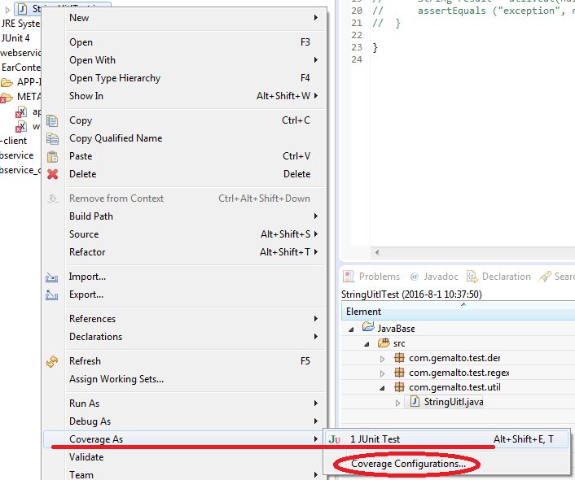
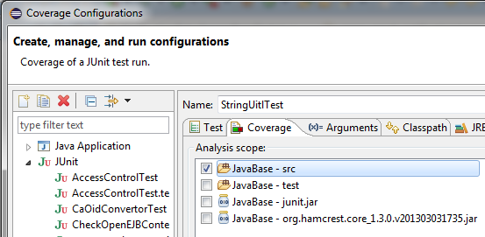
Launching in Coverage Mode

Slide 19
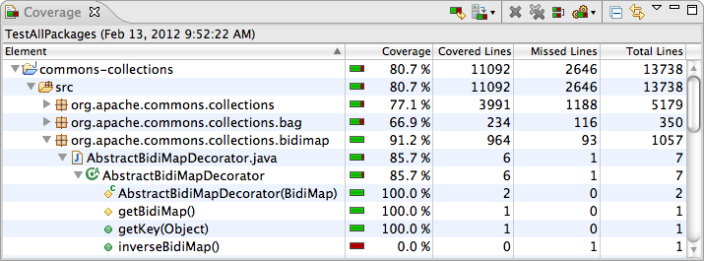
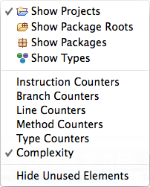
Using the Coverage View

Slide 20
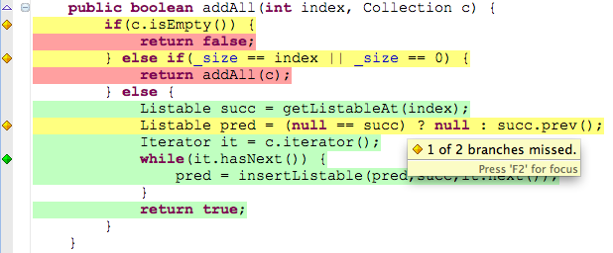
Source Code Annotation

